Slide 1




Analog Life in Impact-induced Endolithic Niches (ALIEN)
Eli Resnick
Northern Arizona University

Slide 2
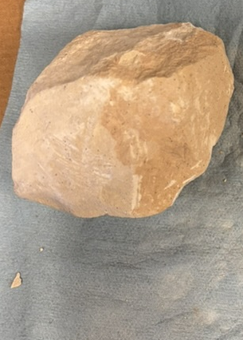
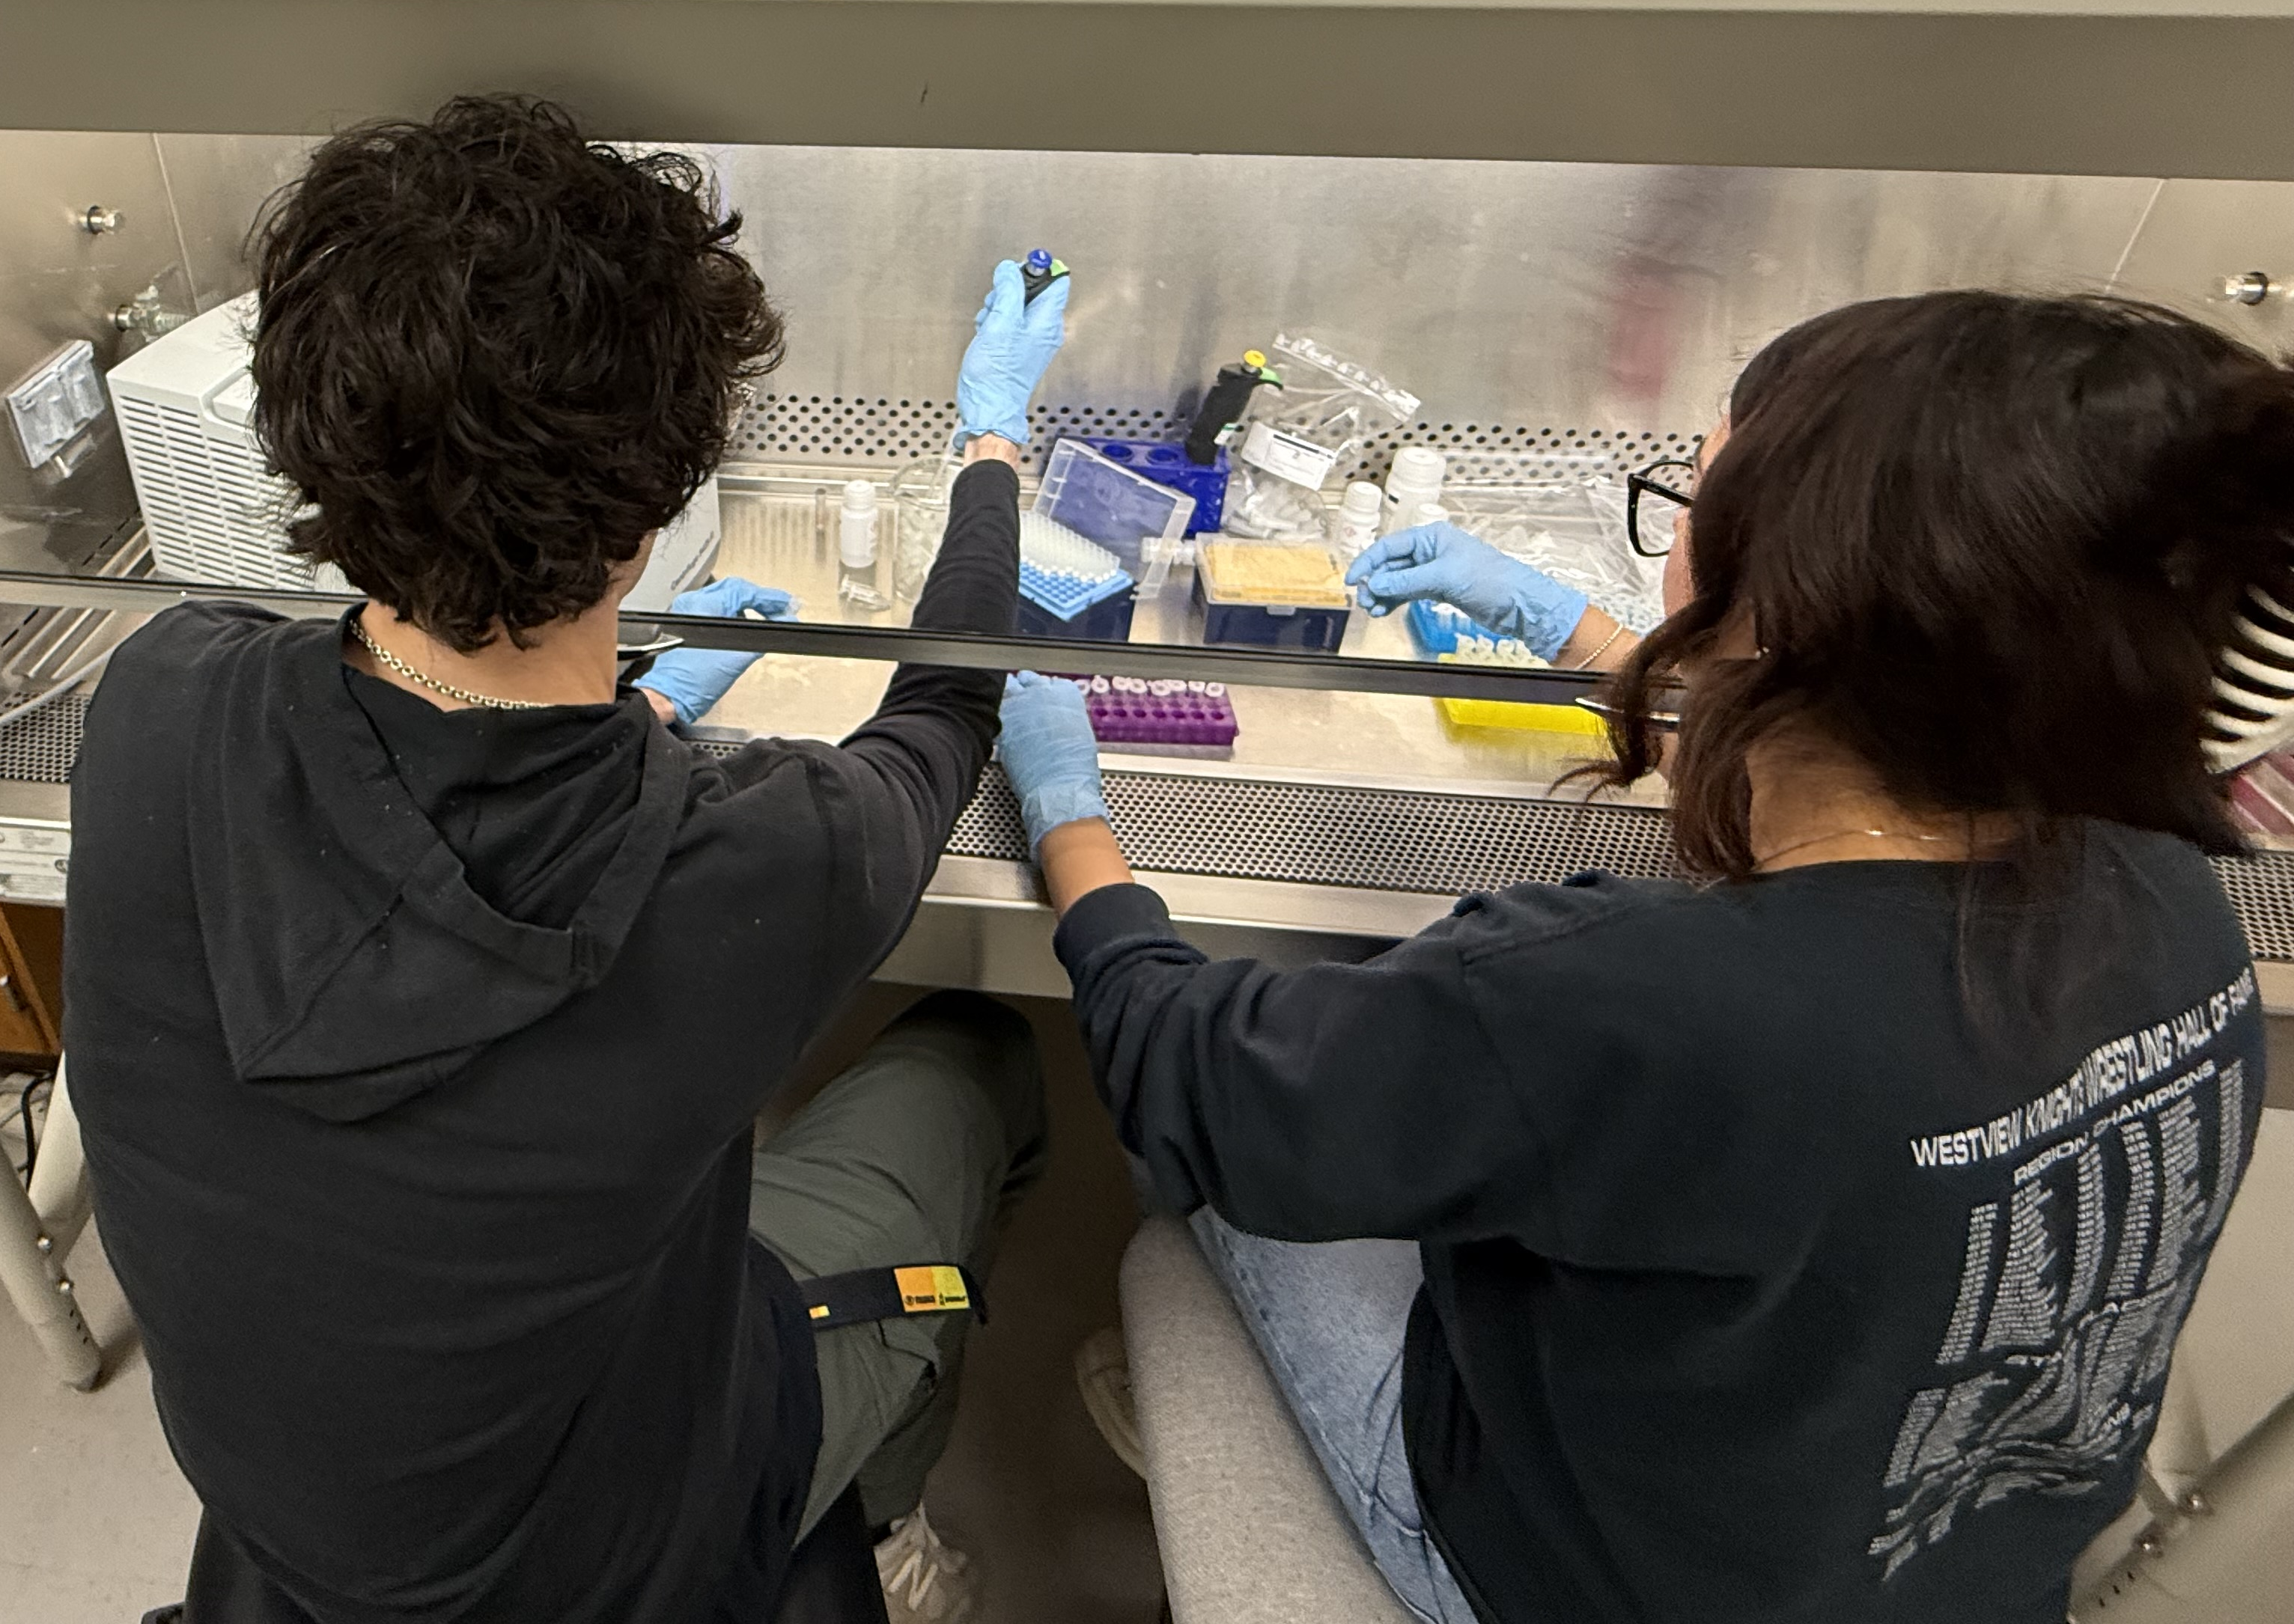

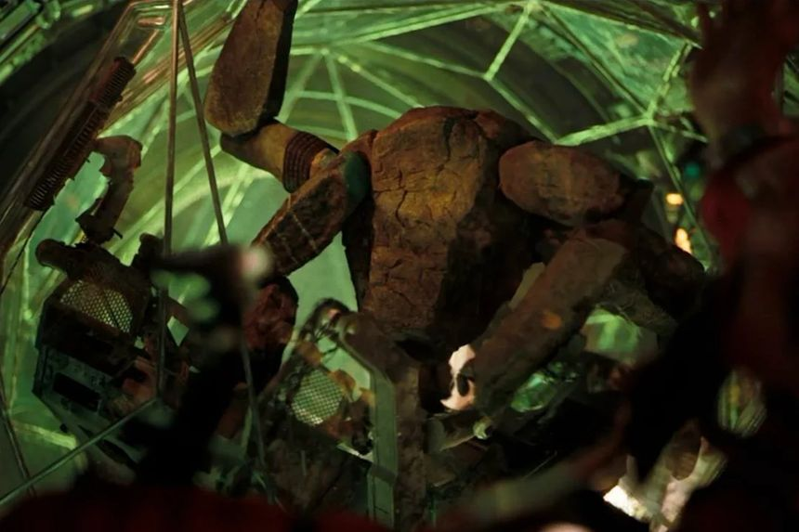
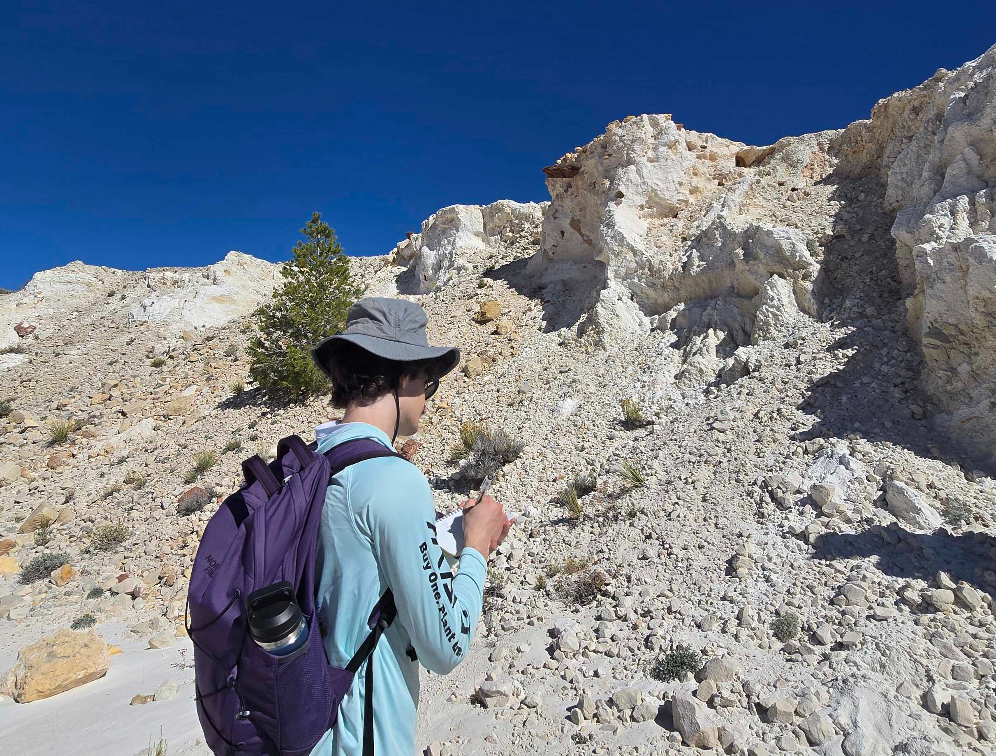

What people think my research is
My research project
Analyzing the microbial diversity of Barringer Crater, AZ
What my research actually is
Credit: Project Hail Mary (top), Toy Story (bottom), unknown (left)

Slide 3
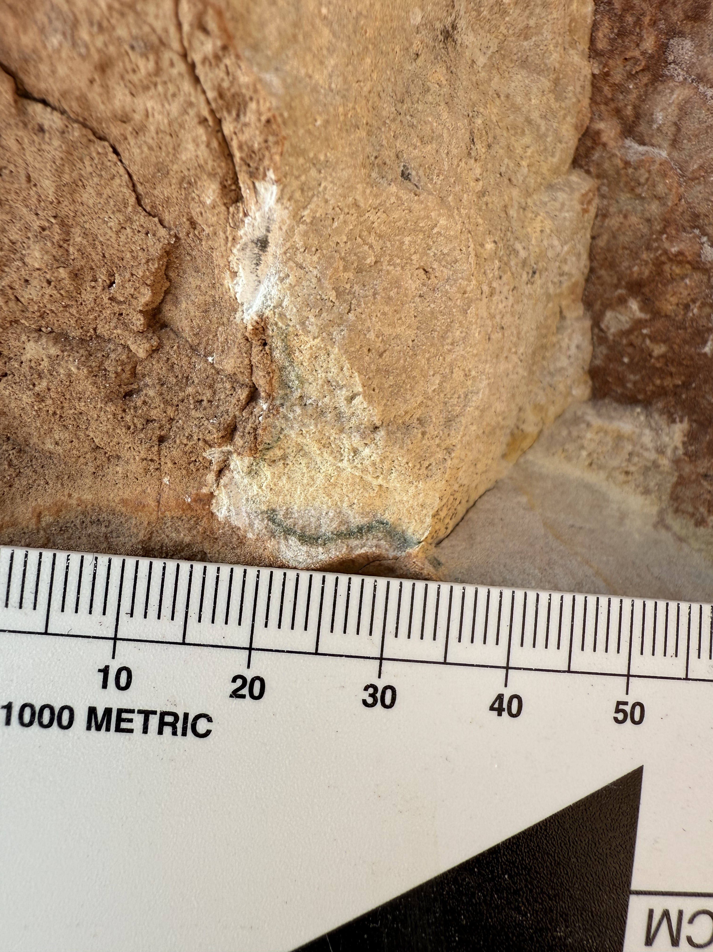
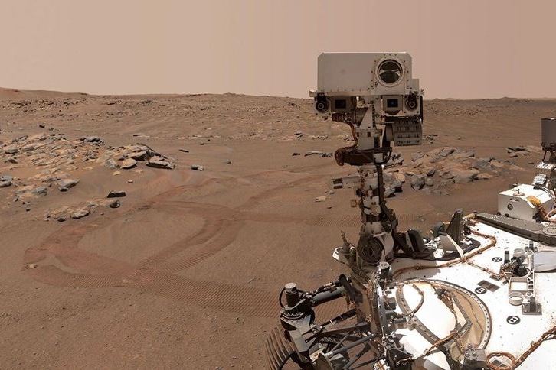
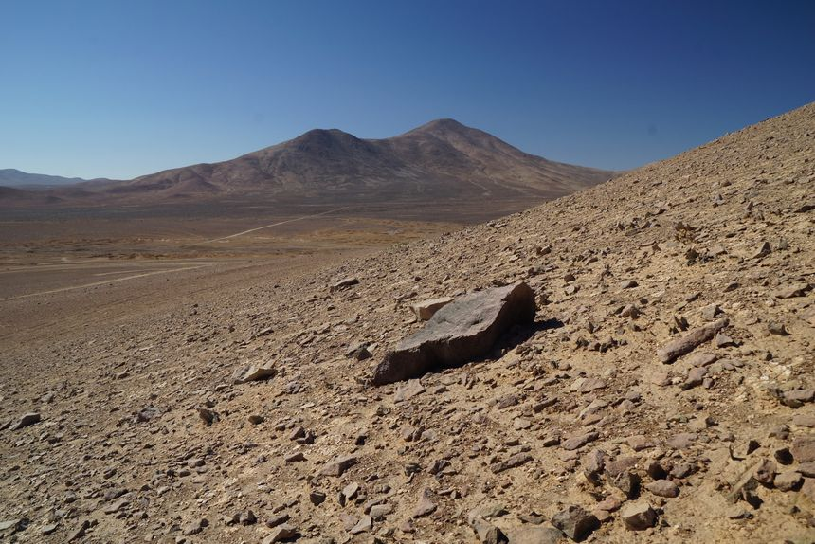
ALIEN - Analog Life
What are analogs?
Environments on Earth similar to another planet
Used as a proxy for studying other planets
Ex: hydrothermal systems, high altitude deserts, and impact craters
What is analog life?
Life found in analog, often extreme environments
Help to understand how life could exist beyond Earth
Extremophiles
Important for detecting
potential biosignatures
Photo of an endolith at Barringer crater
Jezero Crater, Mars. Credit: NASA
Atacama Desert, Earth. Credit: NASA/JPL-Caltech

Slide 4
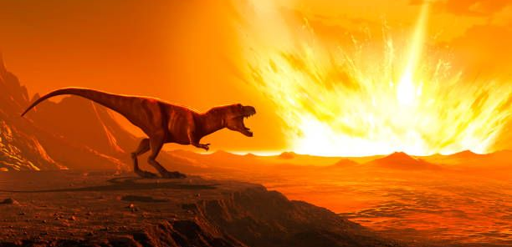
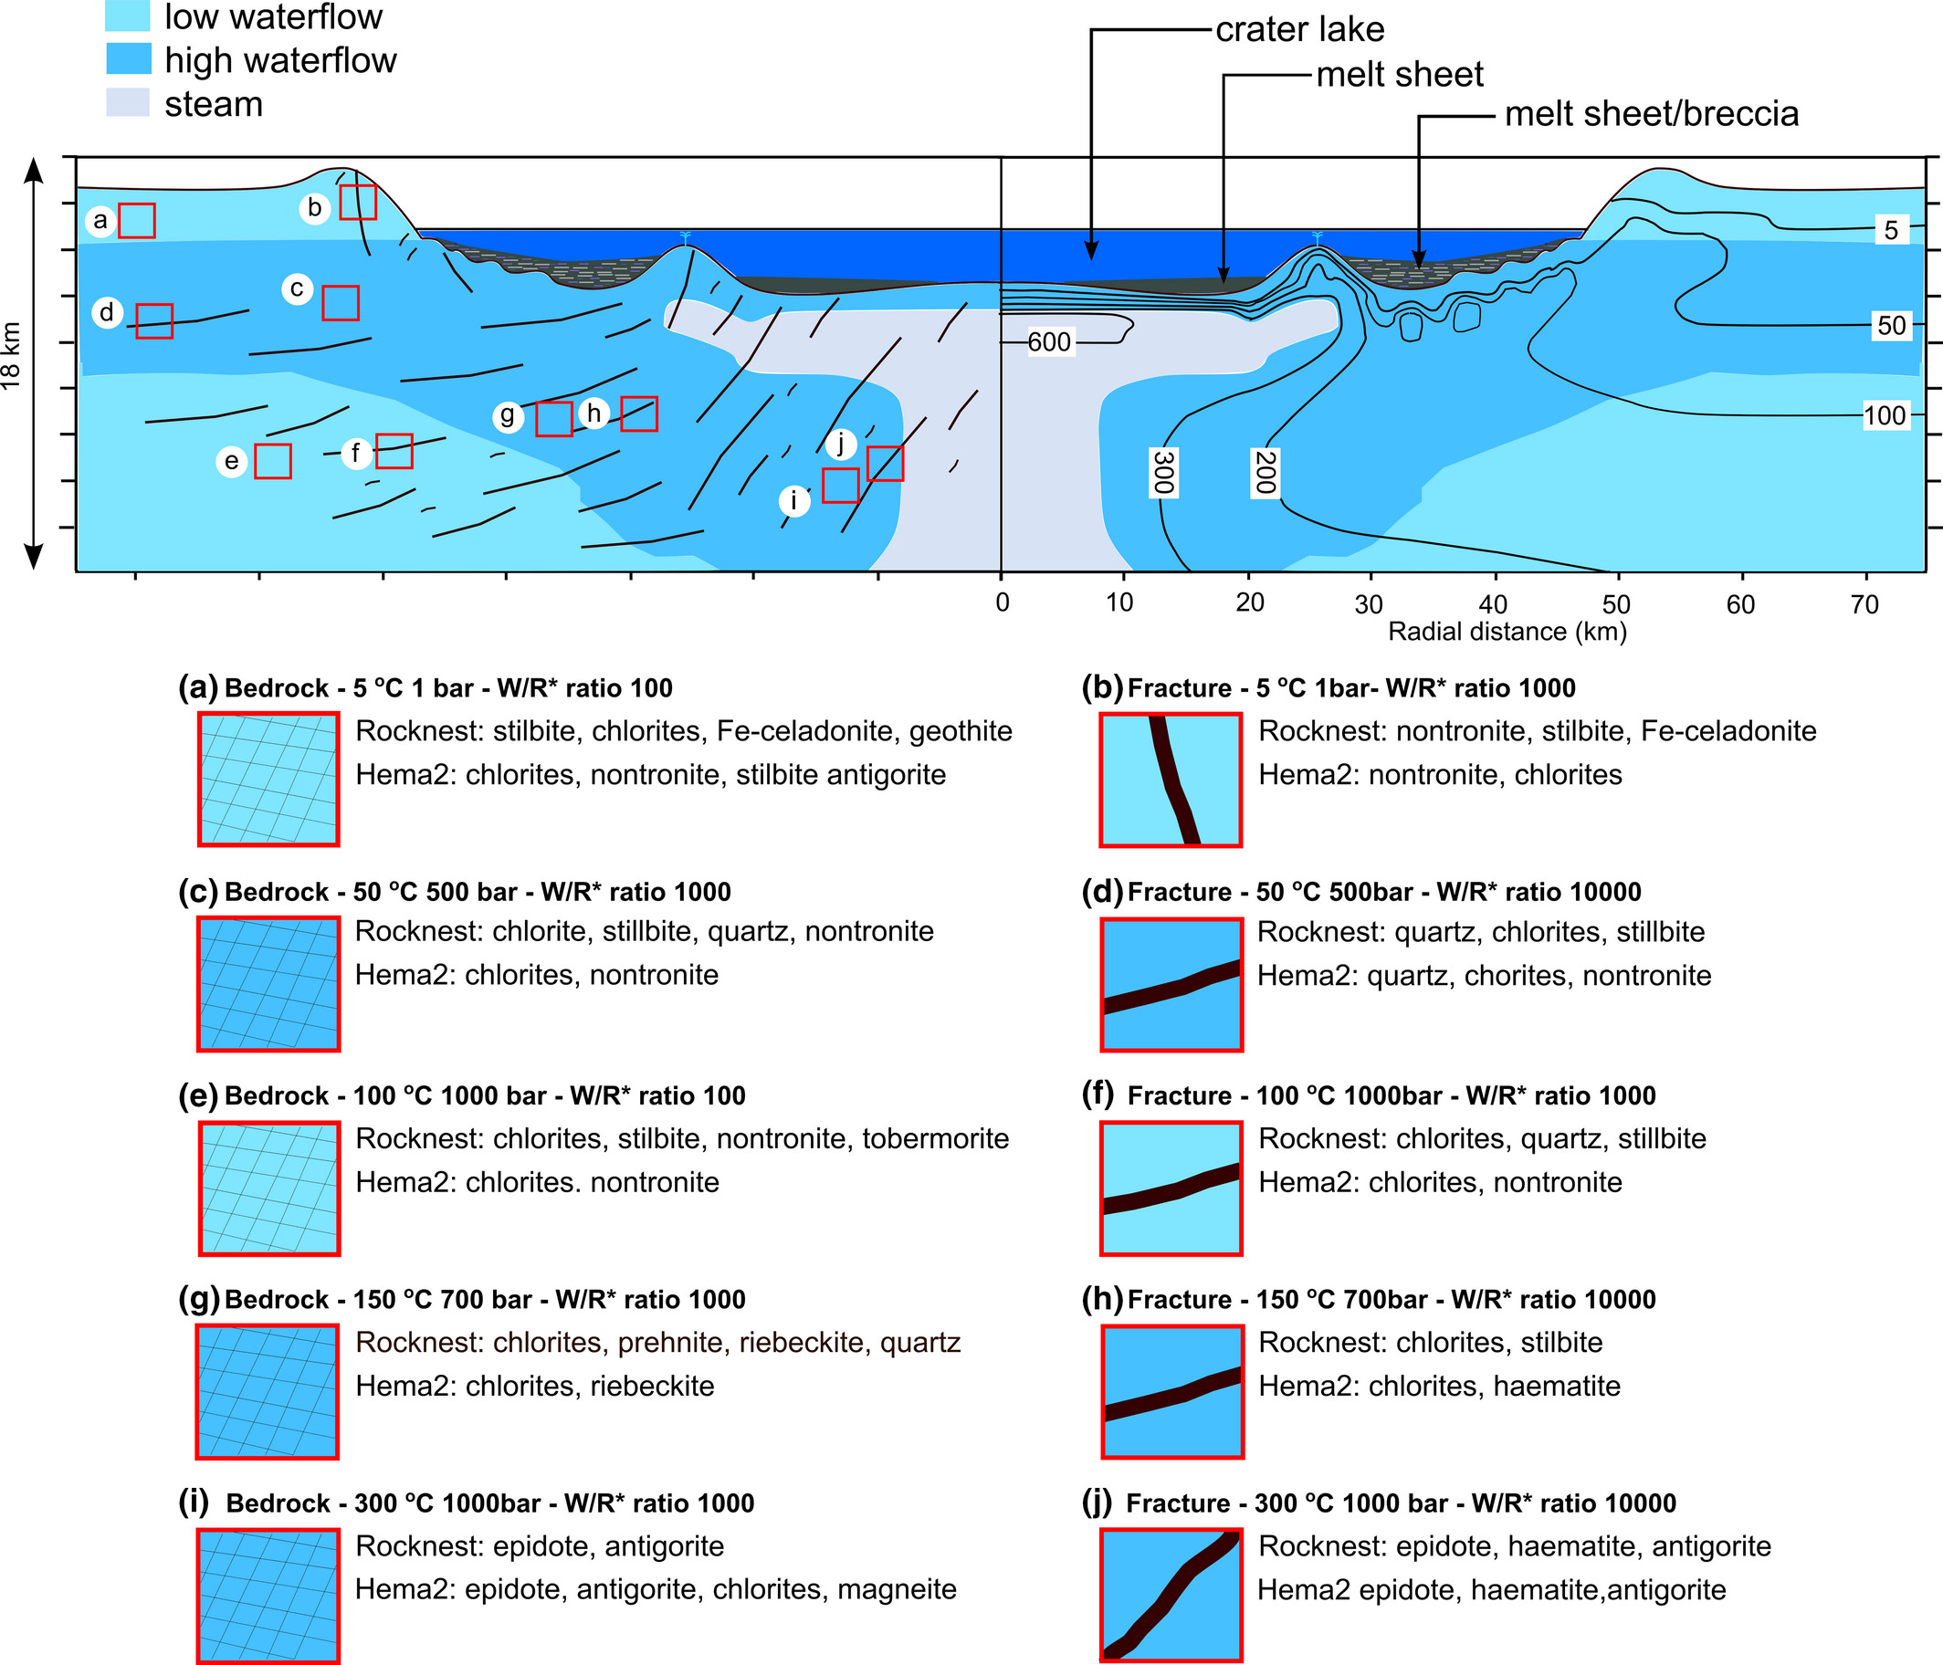
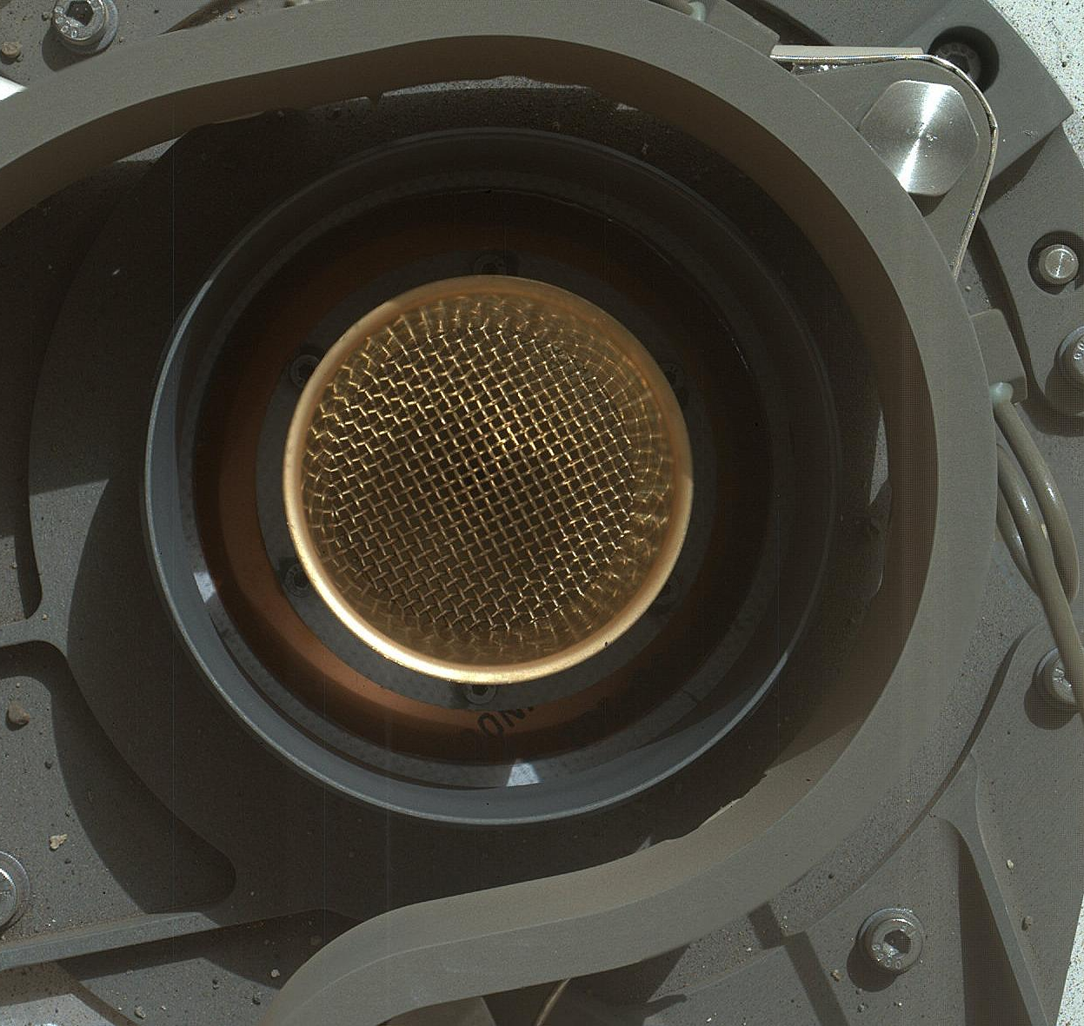
Why impact craters?
ALIEN - Impacts
Artist rendition of meteor impact. Credit: Science Photo Library
Post impact hydrothermal systems
Enough energy to support a significant microbial population
Shock metamorphism
Fracturing
Increased porosity
Microhabitats in target material
Sample inlet of Curiosity rover’s CheMin instrument. Credit: NASA
Modeled mineral compositions across an impact-induced hydrothermal system, Ramkissoon N.K, et al. (2021).

Slide 5
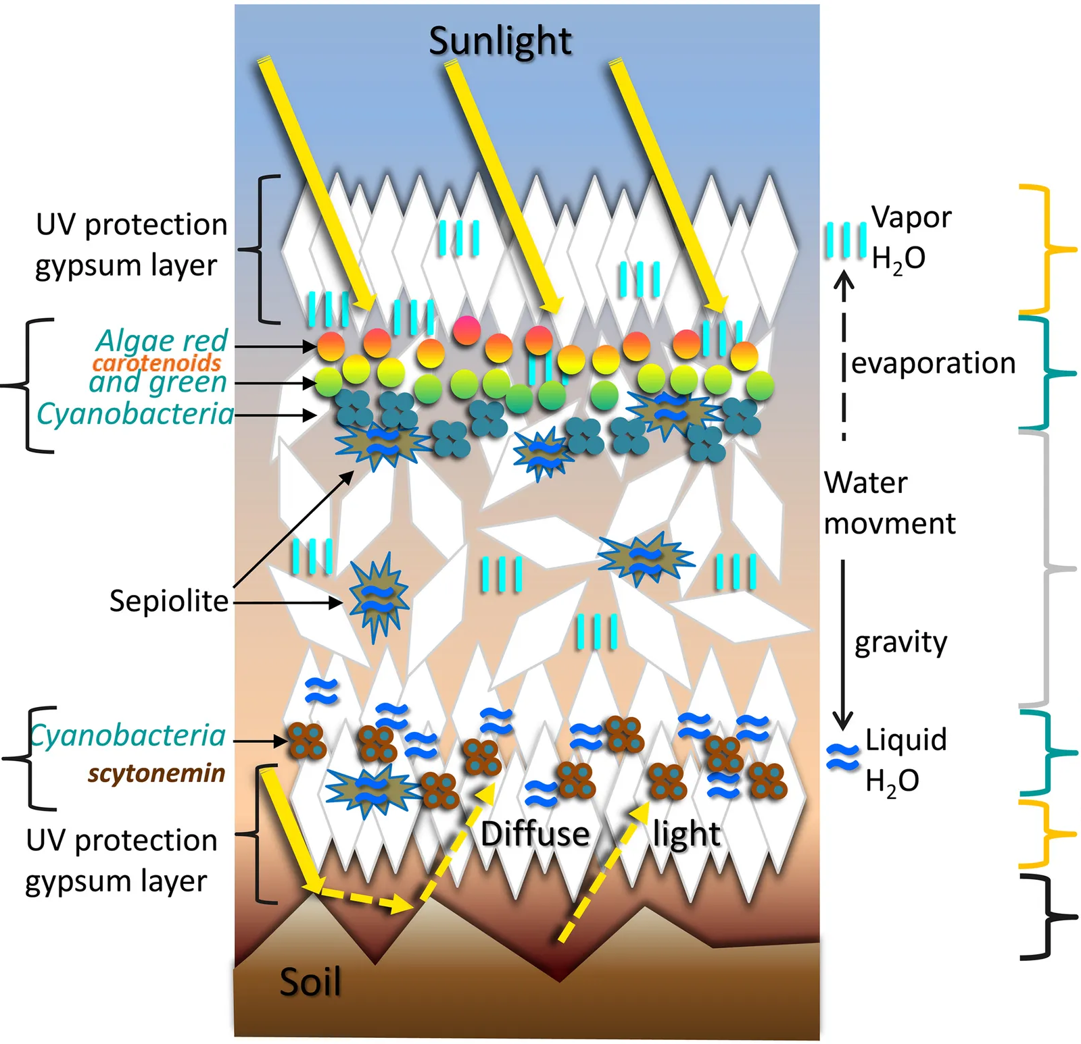
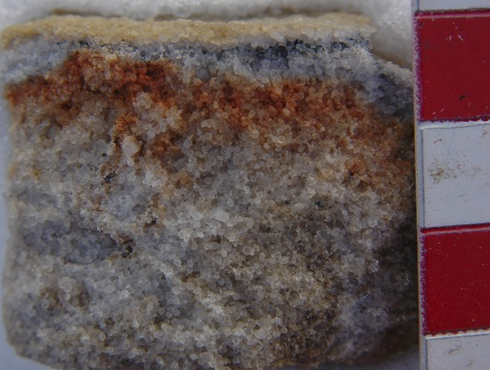
ALIEN – Endolithic Niches
What are endoliths? Why are they important?
Microorganisms living within rocks or mineral grains
Distinct advantages over other forms of microorganisms
Useful for life wanting to survive on Mars
Antarctic endoliths. Image credit: Henry Sun.
Endolithic habitat diagram, Wierzchos J, et al. (2015).
The Martian surface is extreme
High ultraviolet (UV) radiation
Desiccation
Large temperature variance
Endolithic niches protect microbes from extreme conditions
U.V. shielding
Water retention
Temperature stability
U.V. attenuation
Absorption and scattering of light through the rock structure
Protects microbes from harmful U.V. radiation

Slide 6
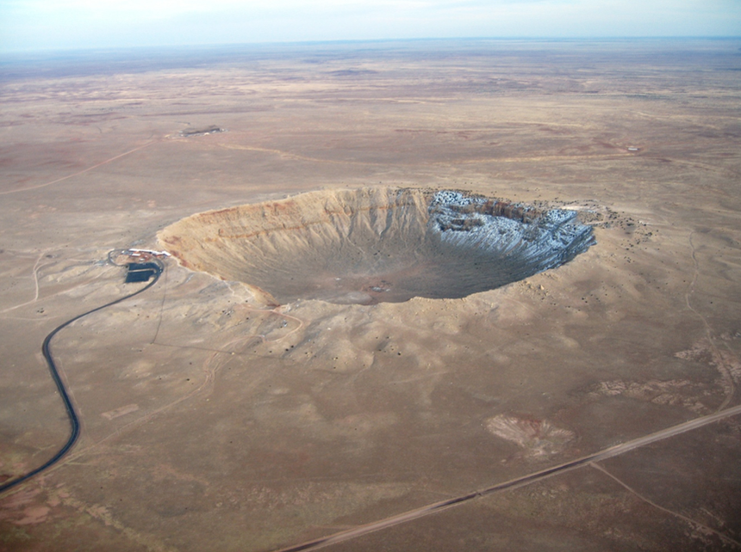
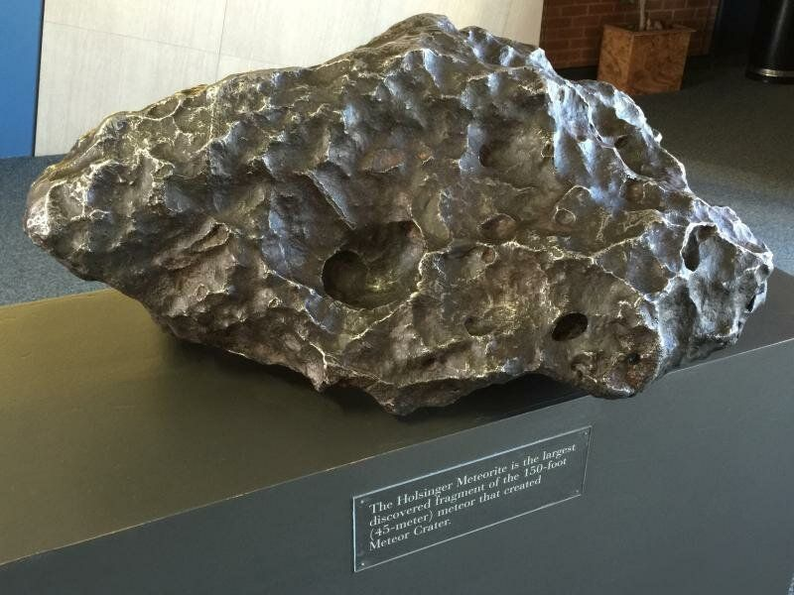
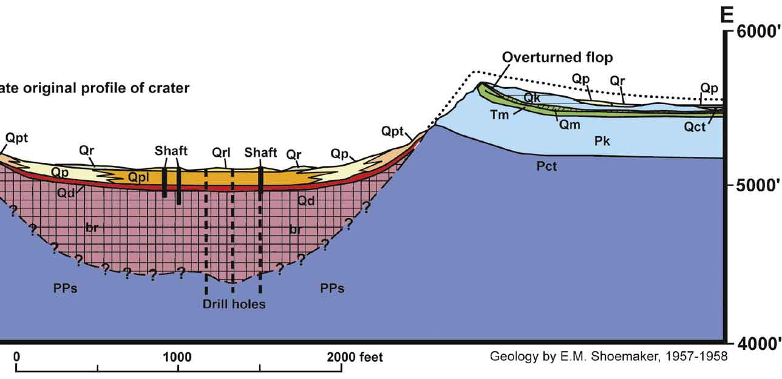
Barringer Crater
~50,000 years old
Located in Winslow, AZ
Formed by an iron-nickel meteorite impact
~1 km across and 100 m deep
MARS ANALOG!
Holsinger meteorite at the Meteor Crater Visitor Center.
3 main stratigraphic groups
Coconino sandstone - blue
Kaibab formation – light blue
Moenkopi formation - green
Barringer crater ariel view. Credit: NASA
Not just any crater
Convenient location (not only on earth, close to NAU)
Well preserved
Desiccation
High U.V. exposure
Large temperature variance
Sound familiar?
Cross-section through Meteor Crater, David A. Kring (2017)

Slide 7
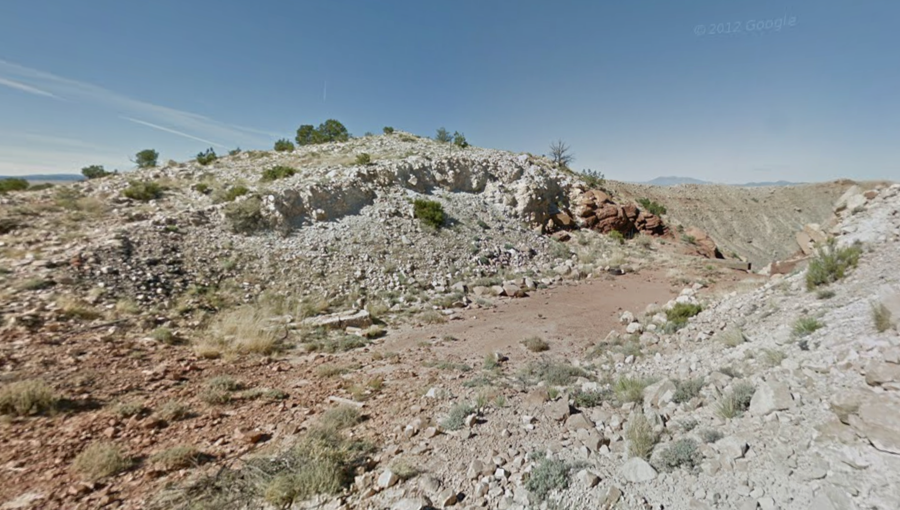
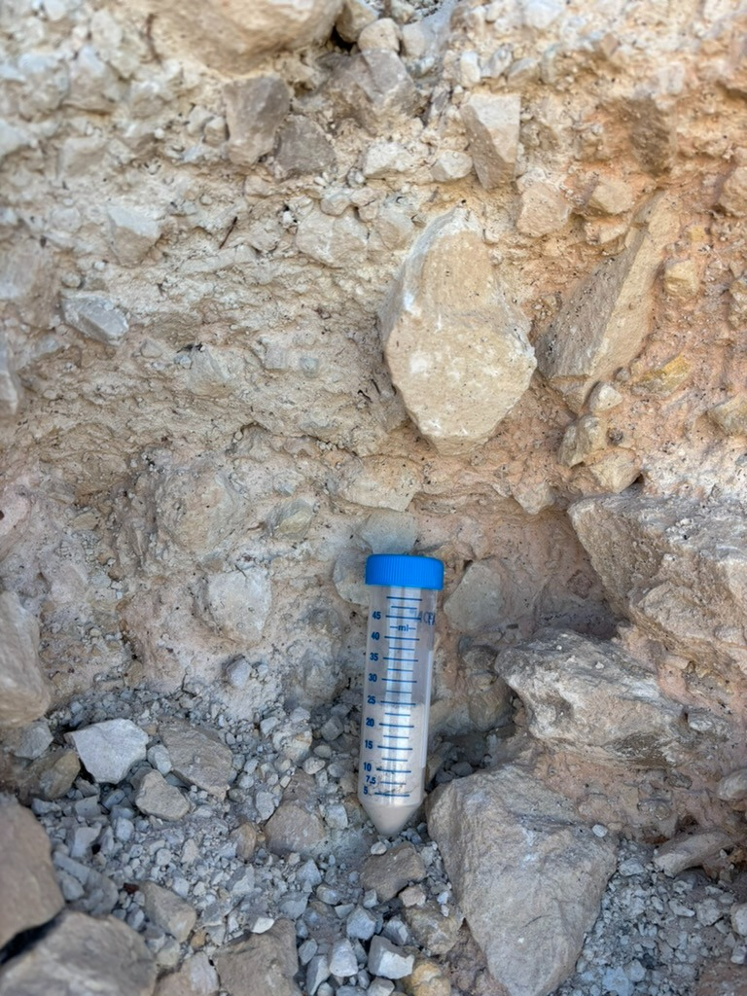
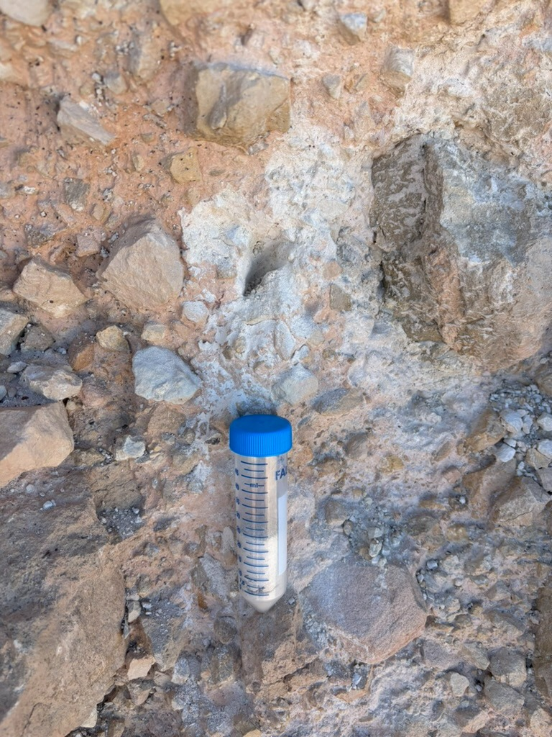
Kaibab impact breccia
Mix of Kaibab rock “clasts” embedded in a “matrix” of finer material
Shocked ejecta unit at Barringer Crater
Composed mostly of dolomitic limestone
The specific site where I am analyzing microbial diversity
Photo of Kaibab impact breccia site at Barringer crater. Credit: Google Earth
Sampling the clast and matrix
Geological sampling
Rock Hammer
Chisel
Sample tubes
Biological sampling
Avoid contamination
Sterilizing tools with RNase or 10%bleach
Comparison between clast (left) and matrix (right) samples

Slide 8
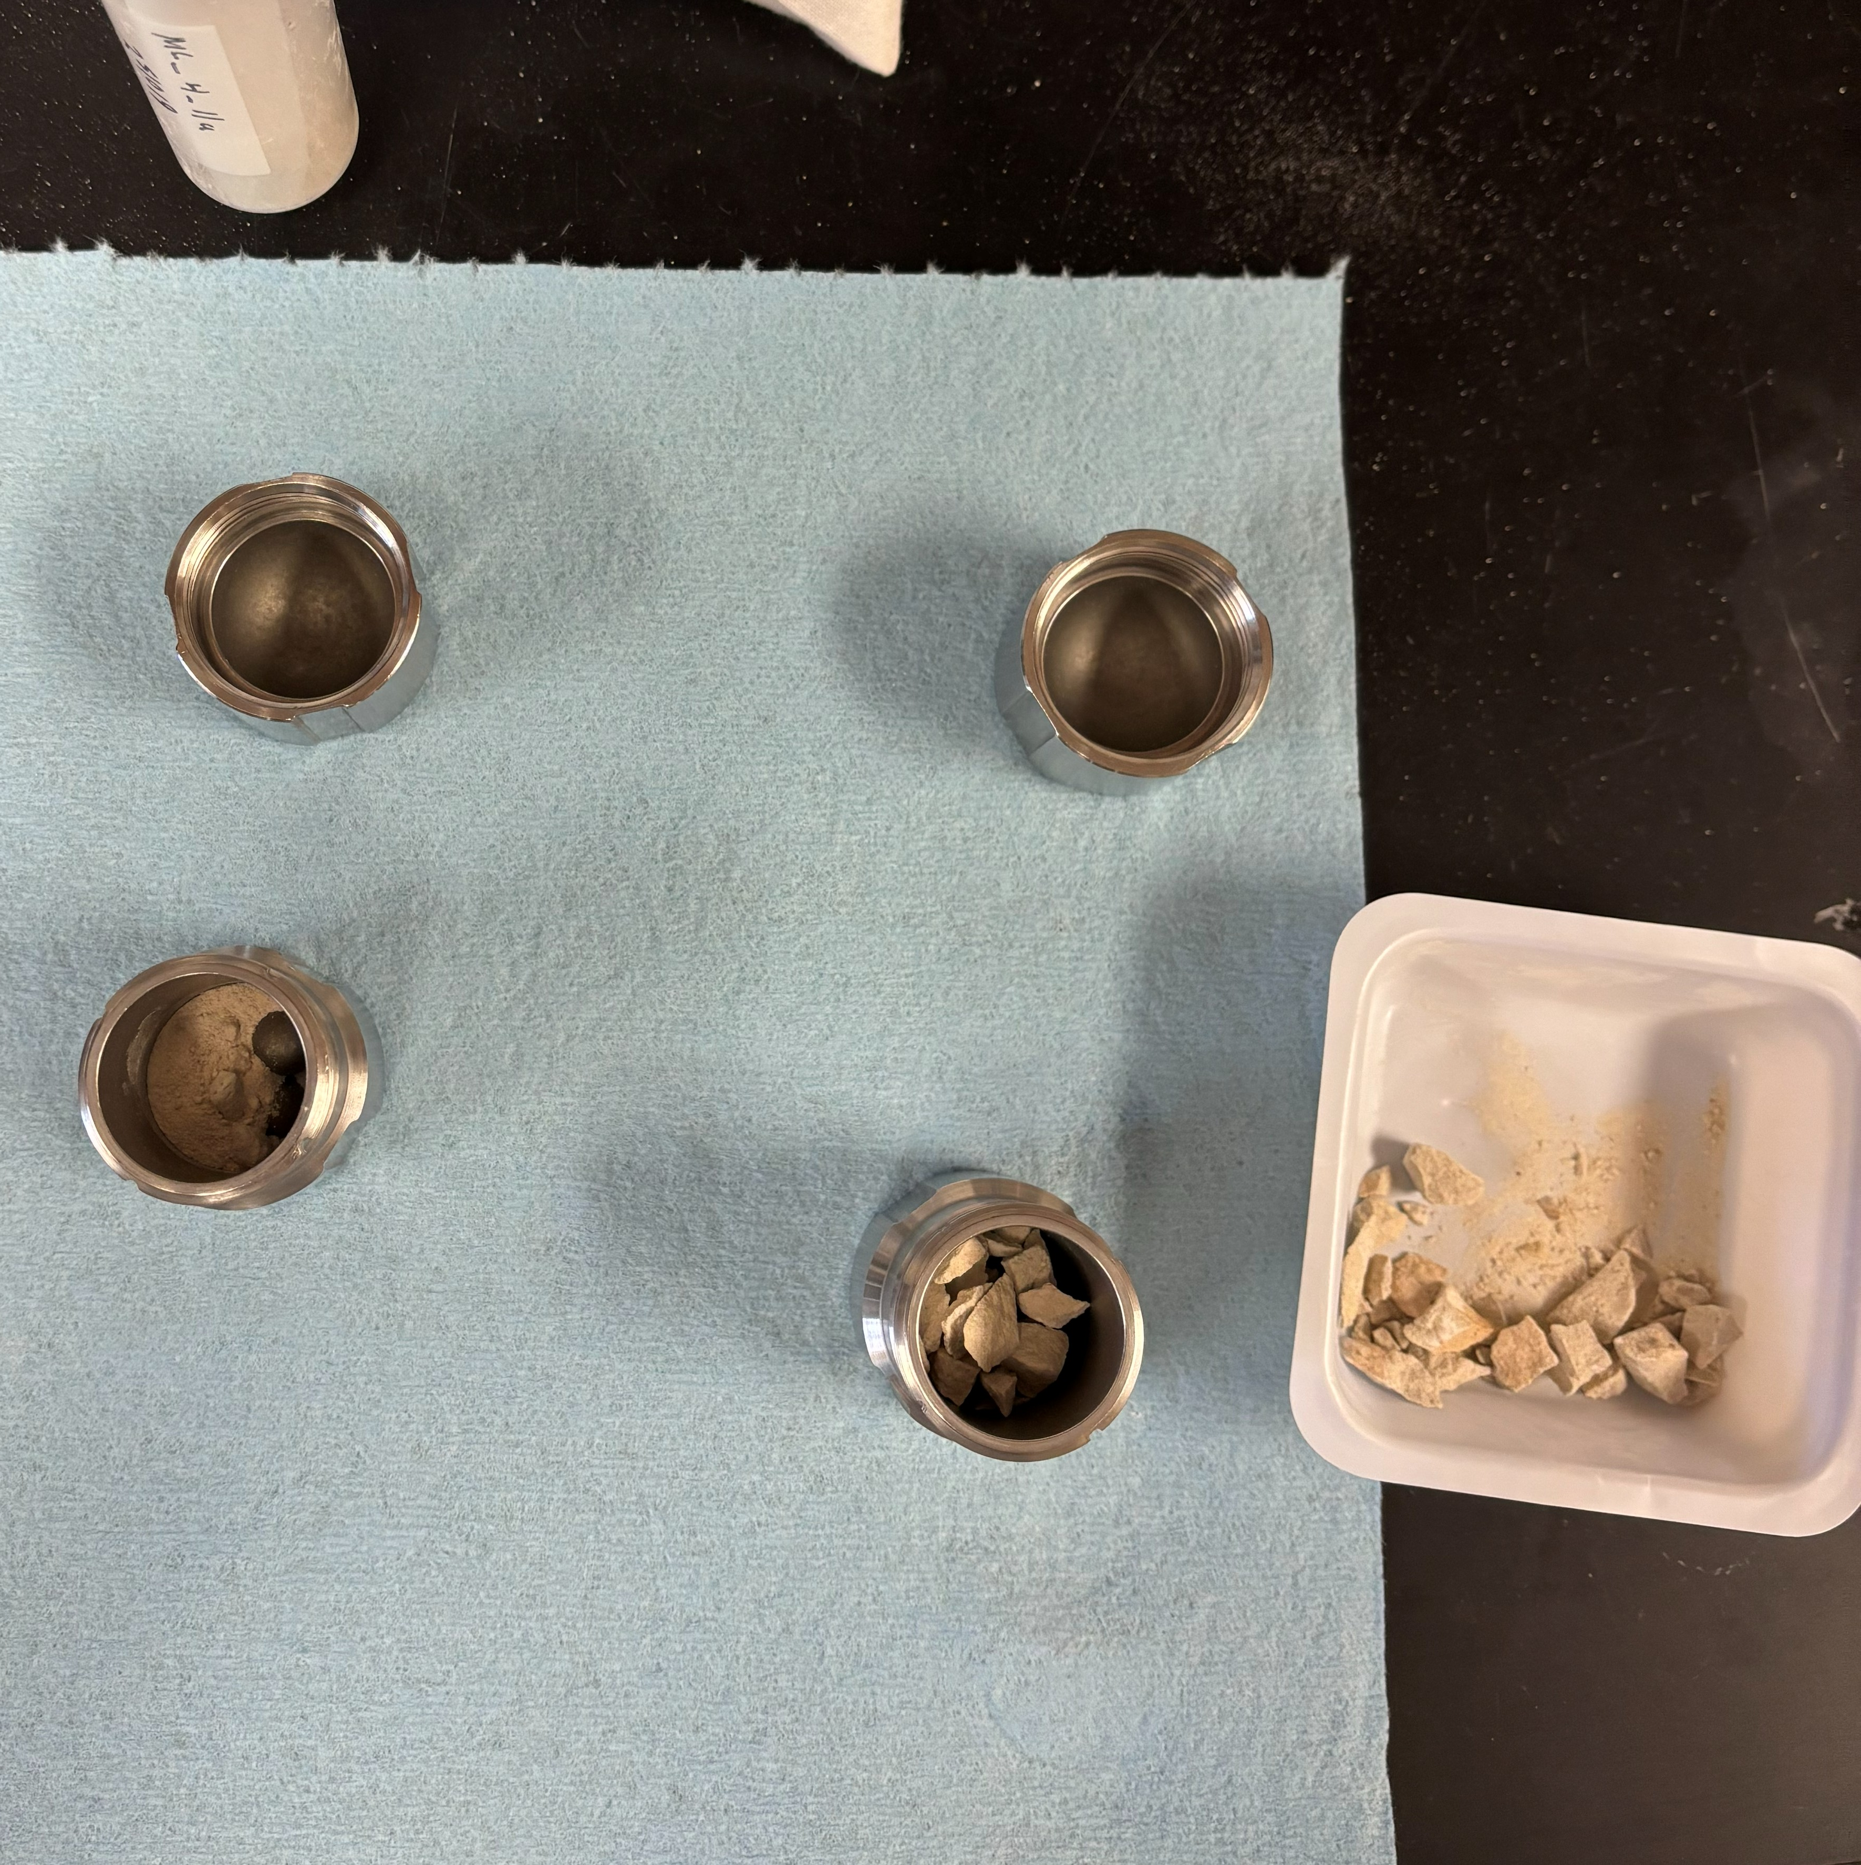
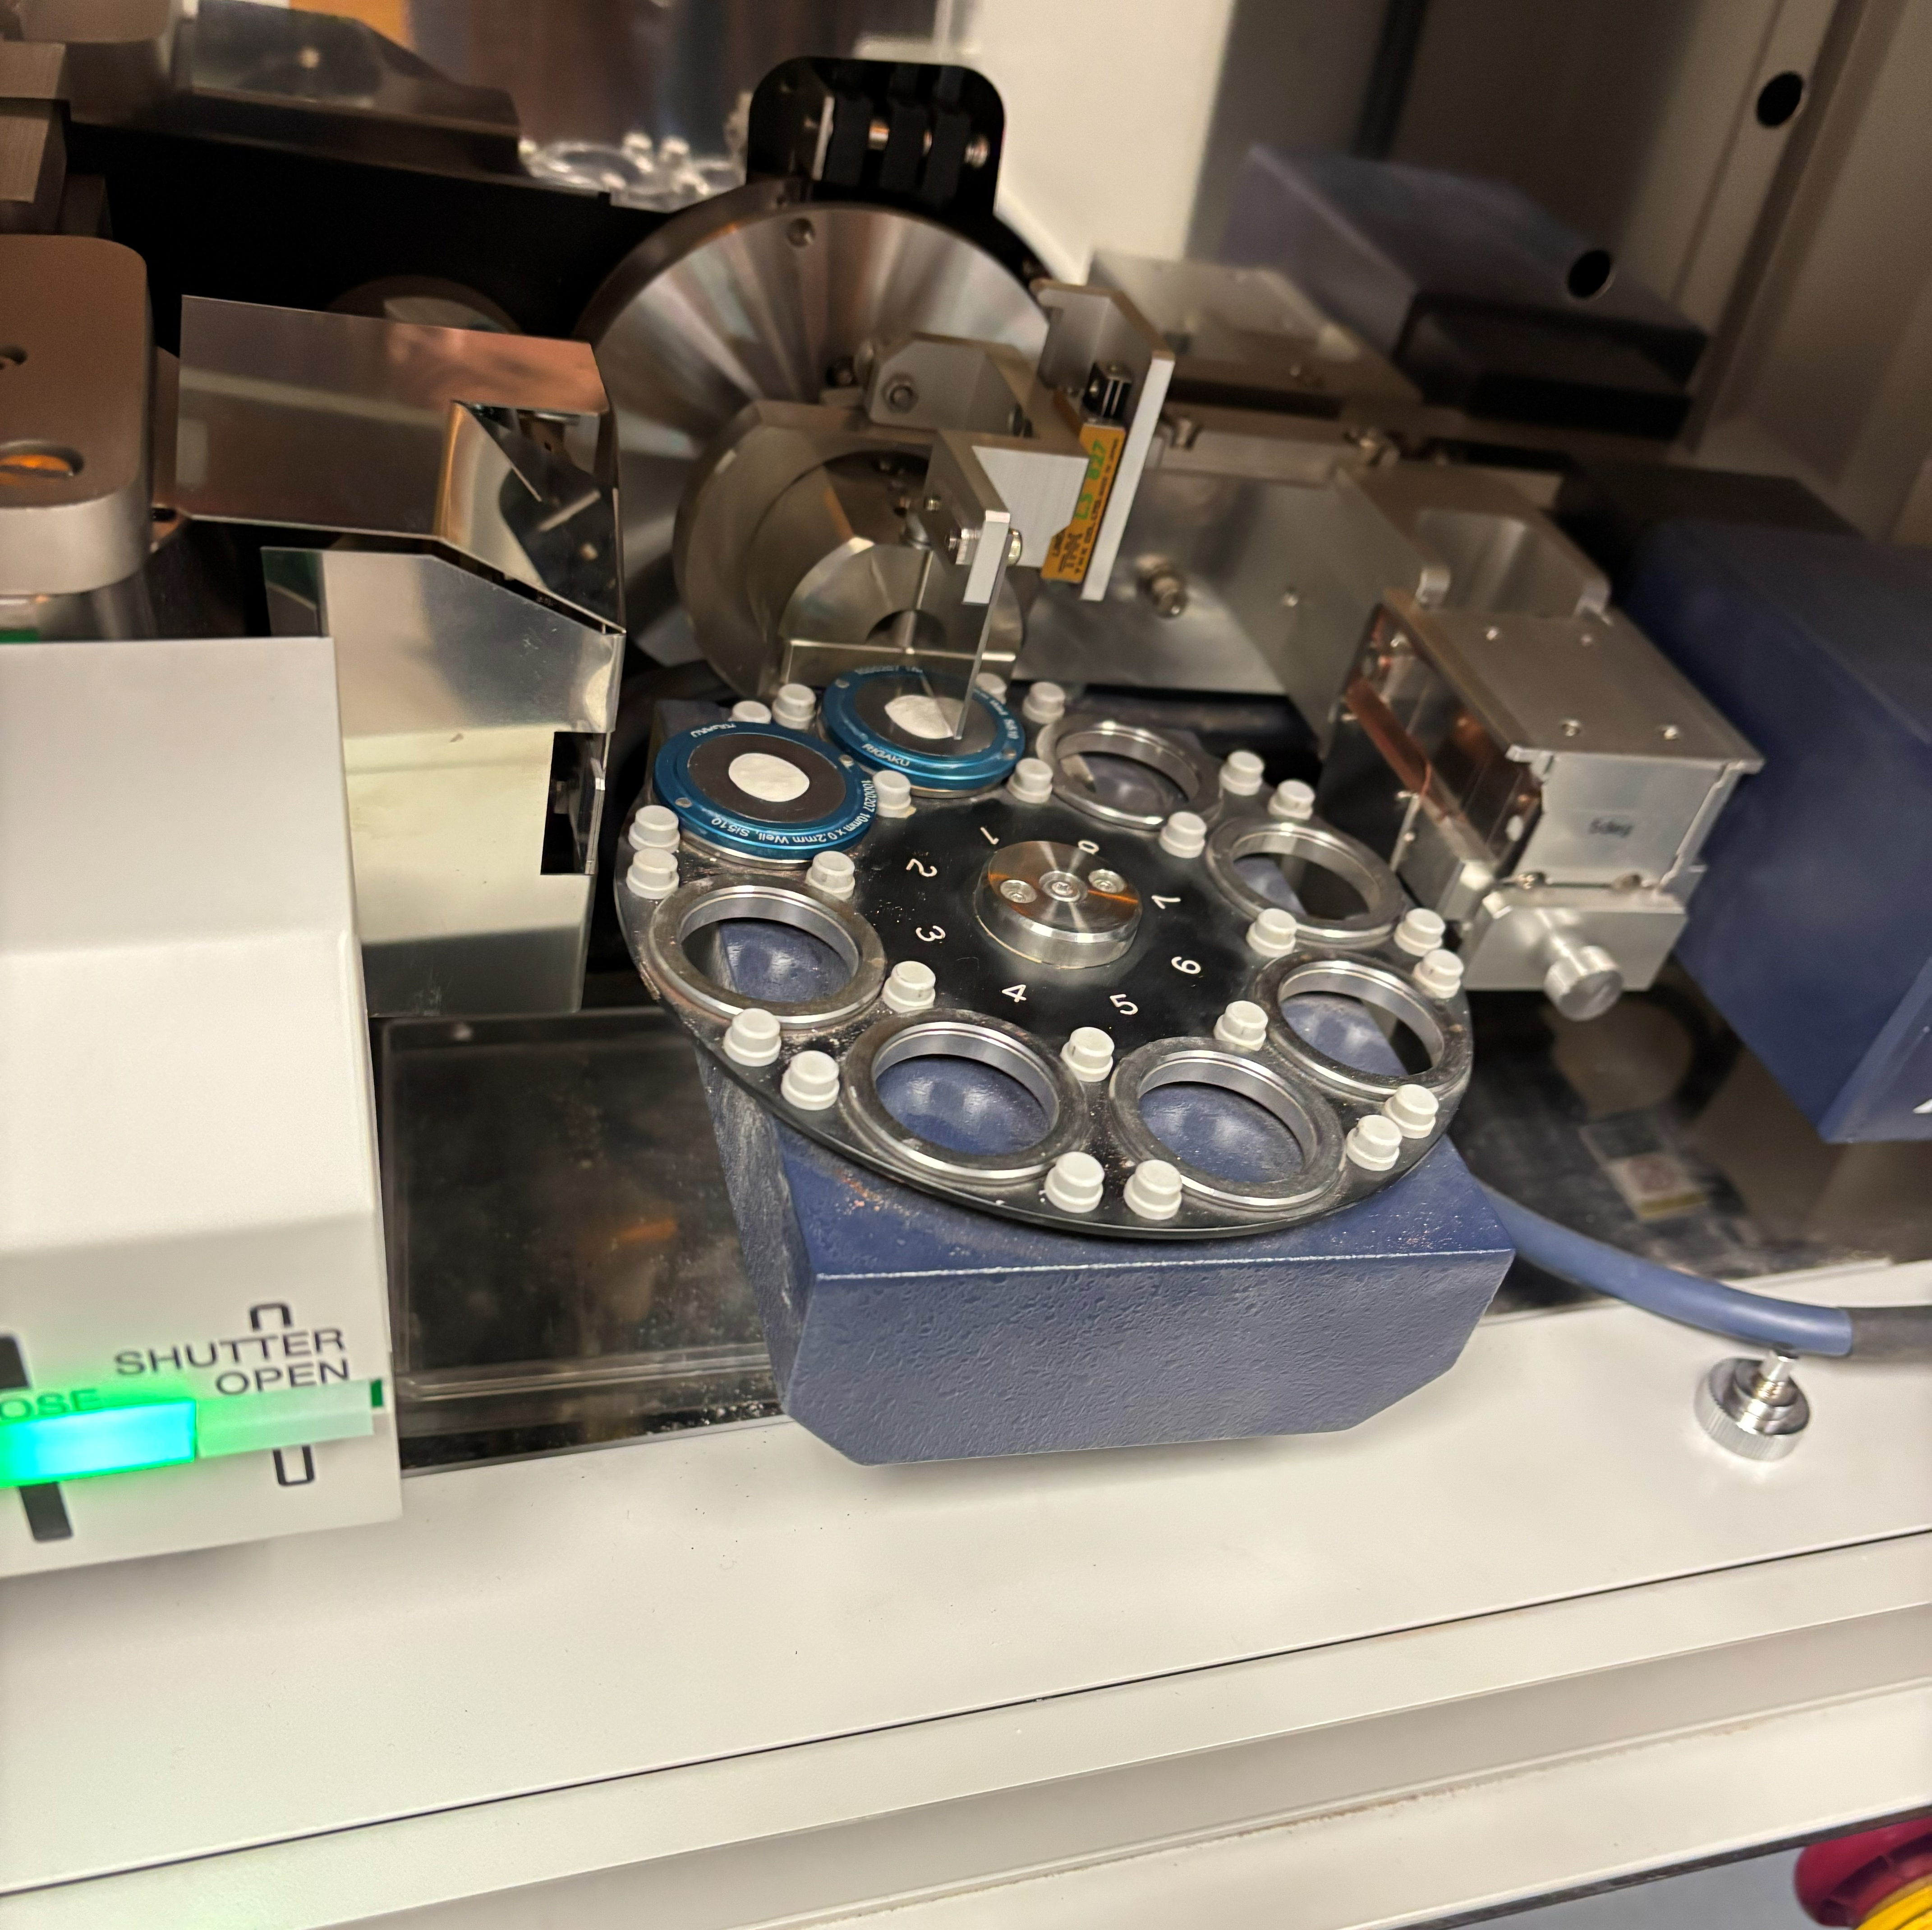
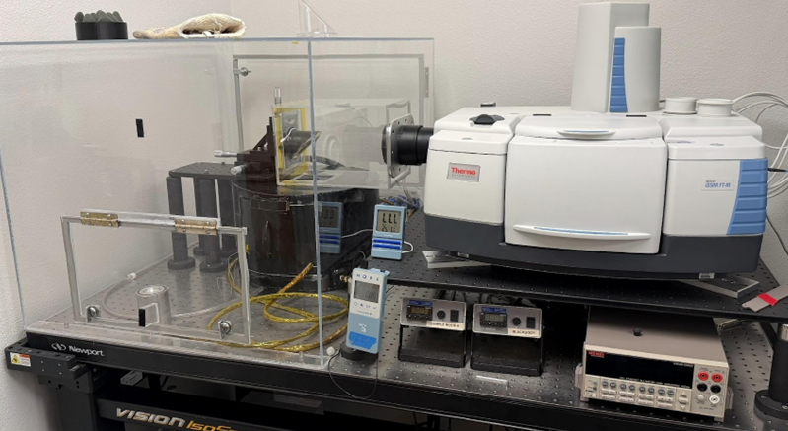
Mineralogical analysis
Sample preparation
Ball mill to homogenize
Sieve to ≤150 μm
Fourier Transform Infrared Spectroscopy (FTIR)
Pellet press sieved sample and heat to ~90C
X-ray Diffraction (XRD)
Load sieved sample onto XRD sample holder
Ball mill crucibles w/ sample material
X-ray Diffractometer w/ samples loaded
FTIR Spectrometer at NAU

Slide 9
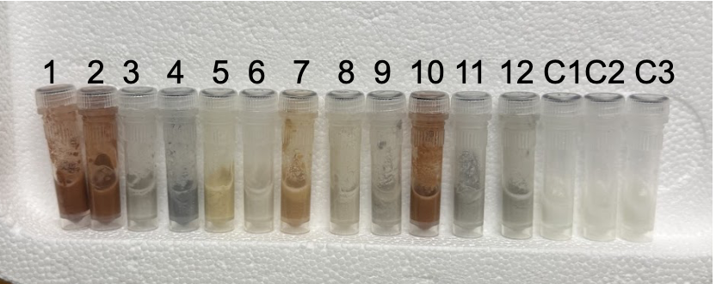
Microbial analysis
Biological crushing
Sterilize ball mill equipment and load sample under a fume hood
Run ball mill in stages to avoid overheating sample
DNA extraction
Triplicate extractions
Adapted workflow specific to our low-biomass samples
Sterilize all equipment and always work under a fume hood
16s rRNA sequencing
Variable regions 3 and 4
Me preforming DNA extraction
12 Biological samples and 3 controls in bead beater tubes

Slide 10
Expected results and impacts
Microbial distribution across the Kaibab impact breccia
Greater diversity of microorganisms in the matrix
May indicate higher permeability and fluid flow
Mineralogy differences in the clast and matrix
Both predominantly dolomitic limestone and sandstone with a small amount of quartz
Greater mineralogical variability in the matrix
Impact of this research
Building our understanding of potentially habitable Martian environments
Developing the unique methods required for low-biomass endolithic sampling and analysis
Future goals
Optimizing the microbial analysis methods
Focus on specific steps (e.g. cell lysis techniques)

Slide 11
Acknowledgements
Special Thanks
Dr. Haley Sapers
Michael Strane
Sam Lockhart
Emalee McCullar
LithoLifeLab group
Barringer Crater Company
NASA Space Grant Consortium

Slide 12
Thank You!

